Slide 1
Chapter 3: SQL

Slide 2
Chapter 3: SQL
Data Definition
Basic Query Structure
Set Operations
Aggregate Functions
Null Values
Nested Subqueries
Complex Queries
Views
Modification of the Database
Joined Relations**
Notes:
1

Slide 3
History
IBM Sequel language developed as part of System R project at the IBM San Jose Research Laboratory
Renamed Structured Query Language (SQL)
ANSI and ISO standard SQL:
  SQL-86
  SQL-89
  SQL-92
  SQL:1999 (language name became Y2K compliant!)
  SQL:2003
Commercial systems offer most, if not all, SQL-92 features, plus varying feature sets from later standards and special proprietary features.
  Not all examples here may work on your particular system.

Slide 4
Data Definition Language
Allows the specification of not only a set of relations but also information about each relation, including:
The schema for each relation.
The domain of values associated with each attribute.
Integrity constraints
The set of indices to be maintained for each relations.
Security and authorization information for each relation.
The physical storage structure of each relation on disk.

Slide 5
Domain Types in SQL
char(n). Fixed length character string, with user-specified length n.
varchar(n). Variable length character strings, with user-specified maximum length n.
int. Integer (a finite subset of the integers that is machine-dependent).
smallint. Small integer (a machine-dependent subset of the integer domain type).
numeric(p,d). Fixed point number, with user-specified precision of p digits, with n digits to the right of decimal point.
real, double precision. Floating point and double-precision floating point numbers, with machine-dependent precision.
float(n). Floating point number, with user-specified precision of at least n digits.
More are covered in Chapter 4.

Slide 6
Create Table Construct
An SQL relation is defined using the create table command:
create table r (A₁ D₁, A₂ D₂, ..., A_{n} D_{n},
(integrity-constraint₁),
...,
(integrity-constraint_{k}))
  r is the name of the relation
  each A_{i} is an attribute name in the schema of relation r
  D_{i} is the data type of values in the domain of attribute A_{i}
Example:
create table branch
(branch_name char(15) not null,
branch_city char(30),
assets integer)

Slide 7
Integrity Constraints in Create Table
not null
primary key (A₁, ..., A_{n} )
Example: Declare branch_name as the primary key for branch
.
create table branch
(branch_name char(15),
branch_city char(30),
assets integer,
primary key (branch_name))
primary key declaration on an attribute automatically ensures not null in SQL-92 onwards, needs to be explicitly stated in SQL-89

Slide 8
Drop and Alter Table Constructs
The drop table command deletes all information about the dropped relation from the database.
The alter table command is used to add attributes to an existing relation:
alter table r add A D
where A is the name of the attribute to be added to relation r and D is the domain of A.
  All tuples in the relation are assigned null as the value for the new attribute.
The alter table command can also be used to drop attributes of a relation:
alter table r drop A
where A is the name of an attribute of relation r
  Dropping of attributes not supported by many databases

Slide 9

Basic Query Structure
SQL is based on set and relational operations with certain modifications and enhancements
A typical SQL query has the form:
select A₁, A₂, ..., A_{n}
from r₁, r₂, ..., r_{m}
where P
  A_{i} represents an attribute
  R_{i} represents a relation
  P is a predicate.
This query is equivalent to the relational algebra expression.
The result of an SQL query is a relation.
Notes:
2

Slide 10
The select Clause
The select clause list the attributes desired in the result of a query
  corresponds to the projection operation of the relational algebra
Example: find the names of all branches in the loan relation:
select branch_name
from loan
In the relational algebra, the query would be:
∏_{branch_name} (loan)
NOTE: SQL names are case insensitive (i.e., you may use upper- or lower-case letters.)
  E.g. Branch_Name ≡ BRANCH_NAME ≡ branch_name
  Some people use upper case wherever we use bold font.
Notes:
3

Slide 11
The select Clause (Cont.)
SQL allows duplicates in relations as well as in query results.
To force the elimination of duplicates, insert the keyword distinct after select.
Find the names of all branches in the loan relations, and remove duplicates
select distinct branch_name
from loan
The keyword all specifies that duplicates not be removed.
select all branch_name
from loan
Notes:
4

Slide 12
The select Clause (Cont.)
An asterisk in the select clause denotes “all attributes”
select *
from loan
The select clause can contain arithmetic expressions involving the operation, +, –, ∗, and /, and operating on constants or attributes of tuples.
The query:
select loan_number, branch_name, amount ∗ 100
from loan
would return a relation that is the same as the loan relation, except that the value of the attribute amount is multiplied by 100.
Notes:
5

Slide 13
The where Clause
The where clause specifies conditions that the result must satisfy
  Corresponds to the selection predicate of the relational algebra.
To find all loan number for loans made at the Perryridge branch with loan amounts greater than $1200.
select loan_number
from loan
where branch_name = 'Perryridge' and amount > 1200
Comparison results can be combined using the logical connectives and, or, and not.
Comparisons can be applied to results of arithmetic expressions.
Notes:
6

Slide 14
The where Clause (Cont.)
SQL includes a between comparison operator
Example: Find the loan number of those loans with loan amounts between $90,000 and $100,000 (that is, ≥ $90,000 and ≤ $100,000)
select loan_number
from loan
where amount between 90000 and 100000
Notes:
7

Slide 15
The from Clause
The from clause lists the relations involved in the query
  Corresponds to the Cartesian product operation of the relational algebra.
Find the Cartesian product borrower X loan
select ∗
from borrower, loan
Find the name, loan number and loan amount of all customers
having a loan at the Perryridge branch.
select customer_name, borrower.loan_number, amount
from borrower, loan
where borrower.loan_number = loan.loan_number and
branch_name = 'Perryridge'
Notes:
8

Slide 16
The Rename Operation
The SQL allows renaming relations and attributes using the as clause:
old-name as new-name
Find the name, loan number and loan amount of all customers; rename the column name loan_number as loan_id.
select customer_name, borrower.loan_number as loan_id, amount
from borrower, loan
where borrower.loan_number = loan.loan_number
Notes:
9

Slide 17
Tuple Variables
Tuple variables are defined in the from clause via the use of the as clause.
Find the customer names and their loan numbers for all customers having a loan at some branch.
select customer_name, T.loan_number, S.amount
from borrower as T, loan as S
where T.loan_number = S.loan_number
Find the names of all branches that have greater assets than
some branch located in Brooklyn.
select distinct T.branch_name
from branch as T, branch as S
where T.assets > S.assets and S.branch_city = 'Brooklyn'
Keyword as is optional and may be omitted
borrower as T ≡ borrower T
Notes:
10

Slide 18
String Operations
SQL includes a string-matching operator for comparisons on character strings. The operator “like” uses patterns that are described using two special characters:
  percent (%). The % character matches any substring.
  underscore (_). The _ character matches any character.
Find the names of all customers whose street includes the substring “Main”.
select customer_name
from customer
where customer_street like '% Main%'
Match the name “Main%”
like 'Main\%' escape '\'
SQL supports a variety of string operations such as
  concatenation (using “||”)
  converting from upper to lower case (and vice versa)
  finding string length, extracting substrings, etc.

Slide 19
Ordering the Display of Tuples
List in alphabetic order the names of all customers having a loan in Perryridge branch
select distinct customer_name
from borrower, loan
where borrower loan_number = loan.loan_number and
branch_name = 'Perryridge'
order by customer_name
We may specify desc for descending order or asc for ascending order, for each attribute; ascending order is the default.
  Example: order by customer_name desc

Slide 20
Duplicates
In relations with duplicates, SQL can define how many copies of tuples appear in the result.
Multiset versions of some of the relational algebra operators – given multiset relations r₁ and r₂:
  1. σ_{θ} (r₁): If there are c₁ copies of tuple t₁ in r₁, and t₁ satisfies selections σ_{θ,}, then there are c₁ copies of t₁ in σ_{θ} (r₁).
  2. Π_{A} (r ): For each copy of tuple t₁ in r₁, there is a copy of tuple Π_{A} (t₁) in Π_{A} (r₁) where Π_{A} (t₁) denotes the projection of the single tuple t₁.
  3. r₁ x r₂ : If there are c₁ copies of tuple t₁ in r₁ and c₂ copies of tuple t₂ in r₂, there are c₁ x c₂ copies of the tuple t₁. t₂ in r₁ x r₂

Slide 21
Duplicates (Cont.)
Example: Suppose multiset relations r₁ (A, B) and r₂ (C) are as follows:
r₁ = {(1, a) (2,a)} r₂ = {(2), (3), (3)}
Then Π_{B}(r₁) would be {(a), (a)}, while Π_{B}(r₁) x r₂ would be
{(a,2), (a,2), (a,3), (a,3), (a,3), (a,3)}
SQL duplicate semantics:
select A₁,, A₂, ..., A_{n}
from r₁, r₂, ..., r_{m}
where P
is equivalent to the multiset version of the expression:

Slide 22
Set Operations
The set operations union, intersect, and except operate on relations and correspond to the relational algebra operations ∪, ∩, −.
Each of the above operations automatically eliminates duplicates; to retain all duplicates use the corresponding multiset versions union all, intersect all and except all.
Suppose a tuple occurs m times in r and n times in s, then, it occurs:
  m + n times in r union all s
  min(m,n) times in r intersect all s
  max(0, m – n) times in r except all s

Slide 23
Set Operations
Find all customers who have a loan, an account, or both:
(select customer_name from depositor)
union
(select customer_name from borrower)
Find all customers who have both a loan and an account.
(select customer_name from depositor)
intersect
(select customer_name from borrower)
Find all customers who have an account but no loan.
(select customer_name from depositor)
except
(select customer_name from borrower)

Slide 24
Aggregate Functions
These functions operate on the multiset of values of a column of a relation, and return a value
avg: average value
min: minimum value
max: maximum value
sum: sum of values
count: number of values

Slide 25
Aggregate Functions (Cont.)
Find the average account balance at the Perryridge branch.
select avg (balance)
from account
where branch_name = 'Perryridge'
Find the number of tuples in the customer relation.
select count (*)
from customer
Find the number of depositors in the bank.
select count (distinct customer_name)
from depositor

Slide 26
Aggregate Functions – Group By
Find the number of depositors for each branch.
select branch_name, count (distinct customer_name)
from depositor, account
where depositor.account_number = account.account_number
group by branch_name
Note: Attributes in select clause outside of aggregate functions must
appear in group by list

Slide 27
Aggregate Functions – Having Clause
Find the names of all branches where the average account balance is more than $1,200.
select branch_name, avg (balance)
from account
group by branch_name
having avg (balance) > 1200
Note: predicates in the having clause are applied after the
formation of groups whereas predicates in the where
clause are applied before forming groups

Slide 28
Null Values
It is possible for tuples to have a null value, denoted by null, for some of their attributes
null signifies an unknown value or that a value does not exist.
The predicate is null can be used to check for null values.
  Example: Find all loan number which appear in the loan relation with null values for amount.
select loan_number
from loan
where amount is null
The result of any arithmetic expression involving null is null
  Example: 5 + null returns null
However, aggregate functions simply ignore nulls
  More on next slide

Slide 29
Null Values and Three Valued Logic
Any comparison with null returns unknown
  Example: 5 < null or null <> null or null = null
Three-valued logic using the truth value unknown:
  OR: (unknown or true) = true,
  (unknown or false) = unknown
  (unknown or unknown) = unknown
  AND: (true and unknown) = unknown,
  (false and unknown) = false,
  (unknown and unknown) = unknown
  NOT: (not unknown) = unknown
  “P is unknown” evaluates to true if predicate P evaluates to unknown
Result of where clause predicate is treated as false if it evaluates to unknown

Slide 30
Null Values and Aggregates
Total all loan amounts
select sum (amount )
from loan
  Above statement ignores null amounts
  Result is null if there is no non-null amount
All aggregate operations except count(*) ignore tuples with null values on the aggregated attributes.

Slide 31
Nested Subqueries
SQL provides a mechanism for the nesting of subqueries.
A subquery is a select-from-where expression that is nested within another query.
A common use of subqueries is to perform tests for set membership, set comparisons, and set cardinality.

Slide 32
Example Query
Find all customers who have both an account and a loan at the bank.
select distinct customer_name
from borrower
where customer_name in (select customer_name
from depositor )
Find all customers who have a loan at the bank but do not have
an account at the bank
select distinct customer_name
from borrower
where customer_name not in (select customer_name
from depositor )

Slide 33
Example Query
Find all customers who have both an account and a loan at the Perryridge branch
select distinct customer_name
from borrower, loan
where borrower.loan_number = loan.loan_number and
branch_name = 'Perryridge' and
(branch_name, customer_name ) in
(select branch_name, customer_name
from depositor, account
where depositor.account_number =
account.account_number )
Note: Above query can be written in a much simpler manner. The
formulation above is simply to illustrate SQL features.

Slide 34
Set Comparison
Find all branches that have greater assets than some branch located in Brooklyn.
select distinct T.branch_name
from branch as T, branch as S
where T.assets > S.assets and
S.branch_city = 'Brooklyn'
Same query using > some clause
select branch_name
from branch
where assets > some
(select assets
from branch
where branch_city = 'Brooklyn')

Slide 35
Definition of Some Clause
F <comp> some r ⇔ ∃ t ∈ r such that (F <comp> t )
Where <comp> can be: <, ≤, >, =, ≠
0
(5 < some
5
) = true
(read: 5 < some tuple in the relation)
6
0
(5 < some
5
) = false
0
(5 = some
) = true
5
0
(5 ≠ some
5
) = true (since 0 ≠ 5)
(= some) ≡ in
However, (≠ some) ≡ not in

Slide 36
Example Query
Find the names of all branches that have greater assets than all branches located in Brooklyn.
select branch_name
from branch
where assets > all
(select assets
from branch
where branch_city = 'Brooklyn')

Slide 37
Definition of all Clause
F <comp> all r ⇔ ∀ t ∈ r (F <comp> t)
0
(5 < all
5
) = false
6
6
(5 < all
) = true
10
4
(5 = all
) = false
5
4
(5 ≠ all
) = true (since 5 ≠ 4 and 5 ≠ 6)
6
(≠ all) ≡ not in
However, (= all) ≡ in

Slide 38
Test for Empty Relations
The exists construct returns the value true if the argument subquery is nonempty.
exists r ⇔ r ≠ Ø
not exists r ⇔ r = Ø

Slide 39
Example Query
Find all customers who have an account at all branches located in Brooklyn.
select distinct S.customer_name
from depositor as S
where not exists (
(select branch_name
from branch
where branch_city = 'Brooklyn')
except
(select R.branch_name
from depositor as T, account as R
where T.account_number = R.account_number and
S.customer_name = T.customer_name ))
Note that X – Y = Ø ⇔ X ⊆ Y
Note: Cannot write this query using = all and its variants

Slide 40
Test for Absence of Duplicate Tuples
The unique construct tests whether a subquery has any duplicate tuples in its result.
Find all customers who have at most one account at the Perryridge branch.
select T.customer_name
from depositor as T
where unique (
select R.customer_name
from account, depositor as R
where T.customer_name = R.customer_name and
R.account_number = account.account_number and
account.branch_name = 'Perryridge')

Slide 41
Example Query
Find all customers who have at least two accounts at the Perryridge branch.
select distinct T.customer_name
from depositor as T
where not unique (
select R.customer_name
from account, depositor as R
where T.customer_name = R.customer_name and
R.account_number = account.account_number and
account.branch_name = 'Perryridge')
Variable from outer level is known as a correlation variable

Slide 42
Derived Relations
SQL allows a subquery expression to be used in the from clause
Find the average account balance of those branches where the average account balance is greater than $1200.
select branch_name, avg_balance
from (select branch_name, avg (balance)
from account
group by branch_name )
as branch_avg ( branch_name, avg_balance )
where avg_balance > 1200
Note that we do not need to use the having clause, since we compute the temporary (view) relation branch_avg in the from clause, and the attributes of branch_avg can be used directly in the where clause.

Slide 43
With Clause
The with clause provides a way of defining a temporary view whose definition is available only to the query in which the with clause occurs.
Find all accounts with the maximum balance
with max_balance (value) as
select max (balance)
from account
select account_number
from account, max_balance
where account.balance = max_balance.value

Slide 44
Complex Queries using With Clause
Find all branches where the total account deposit is greater than the average of the total account deposits at all branches.
with branch_total (branch_name, value) as
select branch_name, sum (balance)
from account
group by branch_name
with branch_total_avg (value) as
select avg (value)
from branch_total
select branch_name
from branch_total, branch_total_avg
where branch_total.value >= branch_total_avg.value

Slide 45
Views
In some cases, it is not desirable for all users to see the entire logical model (that is, all the actual relations stored in the database.)
Consider a person who needs to know a customer’s name, loan number and branch name, but has no need to see the loan amount. This person should see a relation described, in SQL, by
(select customer_name, borrower.loan_number, branch_name
from borrower, loan
where borrower.loan_number = loan.loan_number )
A view provides a mechanism to hide certain data from the view of certain users.
Any relation that is not of the conceptual model but is made visible to a user as a “virtual relation” is called a view.

Slide 46
View Definition
A view is defined using the create view statement which has the form
create view v as < query expression >
where <query expression> is any legal SQL expression. The view name is represented by v.
Once a view is defined, the view name can be used to refer to the virtual relation that the view generates.
When a view is created, the query expression is stored in the database; the expression is substituted into queries using the view.

Slide 47
Example Queries
A view consisting of branches and their customers
create view all_customer as
(select branch_name, customer_name
from depositor, account
where depositor.account_number =
account.account_number )
union
(select branch_name, customer_name
from borrower, loan
where borrower.loan_number = loan.loan_number )
Find all customers of the Perryridge branch
select customer_name
from all_customer
where branch_name = 'Perryridge'

Slide 48
Views Defined Using Other Views
One view may be used in the expression defining another view
A view relation v₁ is said to depend directly on a view relation v₂ if v₂ is used in the expression defining v₁
A view relation v₁ is said to depend on view relation v₂ if either v₁ depends directly to v₂ or there is a path of dependencies from v₁ to v₂
A view relation v is said to be recursive if it depends on itself.

Slide 49
View Expansion
A way to define the meaning of views defined in terms of other views.
Let view v₁ be defined by an expression e₁ that may itself contain uses of view relations.
View expansion of an expression repeats the following replacement step:
repeat
Find any view relation v_{i} in e₁
Replace the view relation v_{i} by the expression defining v_{i}
until no more view relations are present in e₁
As long as the view definitions are not recursive, this loop will terminate

Slide 50
Modification of the Database – Deletion
Delete all account tuples at the Perryridge branch
delete from account
where branch_name = 'Perryridge'
Delete all accounts at every branch located in the city ‘Needham’.
delete from account
where branch_name in (select branch_name
from branch
where branch_city = 'Needham')

Slide 51
Example Query
Delete the record of all accounts with balances below the average at the bank.
delete from account
where balance < (select avg (balance )
from account )
  Problem: as we delete tuples from deposit, the average balance changes
  Solution used in SQL:
  1. First, compute avg balance and find all tuples to delete
  2. Next, delete all tuples found above (without recomputing avg or
  retesting the tuples)

Slide 52
Modification of the Database – Insertion
Add a new tuple to account
insert into account
values ('A-9732', 'Perryridge', 1200)
or equivalently
insert into account (branch_name, balance, account_number)
values ('Perryridge', 1200, 'A-9732')
Add a new tuple to account with balance set to null
insert into account
values ('A-777','Perryridge', null )

Slide 53
Modification of the Database – Insertion
Provide as a gift for all loan customers of the Perryridge branch, a $200 savings account. Let the loan number serve as the account number for the new savings account
insert into account
select loan_number, branch_name, 200
from loan
where branch_name = 'Perryridge'
insert into depositor
select customer_name, loan_number
from loan, borrower
where branch_name = 'Perryridge'
and loan.account_number = borrower.account_number
The select from where statement is evaluated fully before any of its results are inserted into the relation (otherwise queries like
insert into table1 select * from table1
would cause problems)

Slide 54
Modification of the Database – Updates
Increase all accounts with balances over $10,000 by 6%, all other accounts receive 5%.
  Write two update statements:
  update account
  set balance = balance ∗ 1.06
  where balance > 10000
  update account
  set balance = balance ∗ 1.05
  where balance ≤ 10000
  The order is important
  Can be done better using the case statement (next slide)

Slide 55
Case Statement for Conditional Updates
Same query as before: Increase all accounts with balances over $10,000 by 6%, all other accounts receive 5%.
update account
set balance = case
when balance <= 10000 then balance *1.05
else balance * 1.06
end

Slide 56
Update of a View
Create a view of all loan data in the loan relation, hiding the amount attribute
create view loan_branch as
select loan_number, branch_name
from loan
Add a new tuple to branch_loan
insert into branch_loan
values ('L-37‘, 'Perryridge‘)
This insertion must be represented by the insertion of the tuple
('L-37', 'Perryridge', null )
into the loan relation

Slide 57
Updates Through Views (Cont.)
Some updates through views are impossible to translate into updates on the database relations
  create view v as
  select loan_number, branch_name, amount
  from loan
  where branch_name = ‘Perryridge’
insert into v values ( 'L-99','Downtown', '23')
Others cannot be translated uniquely
  insert into all_customer values ('Perryridge', 'John')
    Have to choose loan or account, and
    create a new loan/account number!
Most SQL implementations allow updates only on simple views (without aggregates) defined on a single relation

Slide 58

Joined Relations**
Join operations take two relations and return as a result another relation.
These additional operations are typically used as subquery expressions in the from clause
Join condition – defines which tuples in the two relations match, and what attributes are present in the result of the join.
Join type – defines how tuples in each relation that do not match any tuple in the other relation (based on the join condition) are treated.

Slide 59

Joined Relations – Datasets for Examples
Relation loan
Relation borrower
Note: borrower information missing for L-260 and loan information missing for L-155

Slide 60


Joined Relations – Examples
loan inner join borrower on
loan.loan_number = borrower.loan_number
loan left outer join borrower on
loan.loan_number = borrower.loan_number

Slide 61

Joined Relations – Examples
loan natural inner join borrower
loan natural right outer join borrower

Slide 62

Joined Relations – Examples
loan full outer join borrower using (loan_number)
Find all customers who have either an account or a loan (but not both) at the bank.
select customer_name
from (depositor natural full outer join borrower )
where account_number is null or loan_number is null

Slide 63
Triggers
SQL TRIGGERS
Triggers are nothing but the procedures/functions that involve actions and fired/executed automatically whenever an event occurs such as an insert, delete, or update operation or pressing a button or when mouse button is clicked

Slide 64
Syntax
CREATE [OR REPLACE ] TRIGGER trigger_name
{BEFORE | AFTER | INSTEAD OF }
{INSERT [OR] | UPDATE [OR] | DELETE}
[OF col_name]
ON table_name
[REFERENCING OLD AS o NEW AS n]
[FOR EACH ROW]
WHEN (condition)
DECLARE
Declaration-statements
BEGIN
Executable-statements
EXCEPTION
Exception-handling-statements
END;

Slide 65
Example
set serveroutput on;
CREATE OR REPLACE TRIGGER display_fees_changes
BEFORE DELETE OR INSERT OR UPDATE ON st
FOR EACH ROW
WHEN (NEW.ID > 5)
DECLARE
fees_diff number;
BEGIN
fees_diff := :NEW.fees - :OLD.fees;
dbms_output.put_line('Old fees: ' || :OLD.fees);
dbms_output.put_line('New fees: ' || :NEW.fees);
dbms_output.put_line('Salary difference: ' || fees_diff);
END;
/

Slide 66
Trigger created.
INSERT INTO st(ID,fees)
VALUES (15,1000);
Old fees:
New fees: 1000
Salary difference:
select * from st;
UPDATE st
SET fees = fees + 500
WHERE id = 15;
Old fees: 1000
New fees: 1500
Salary difference: 500

Slide 67
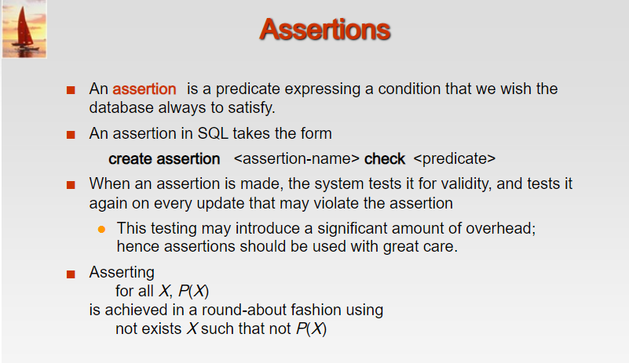

Slide 68
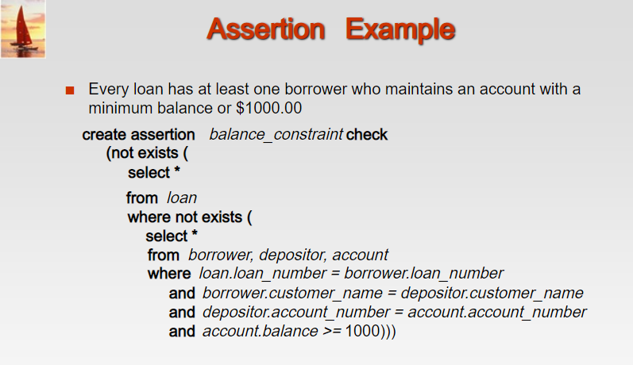

Slide 69
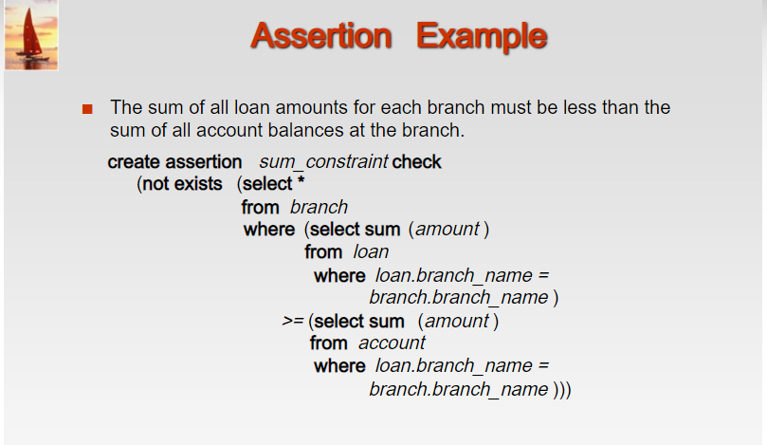

Slide 70
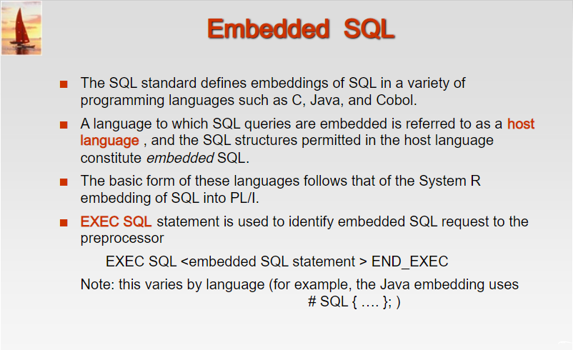

Slide 71
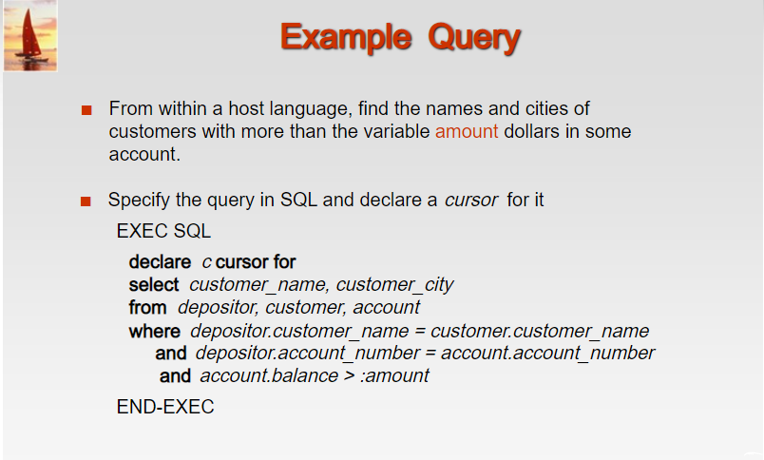

Slide 72
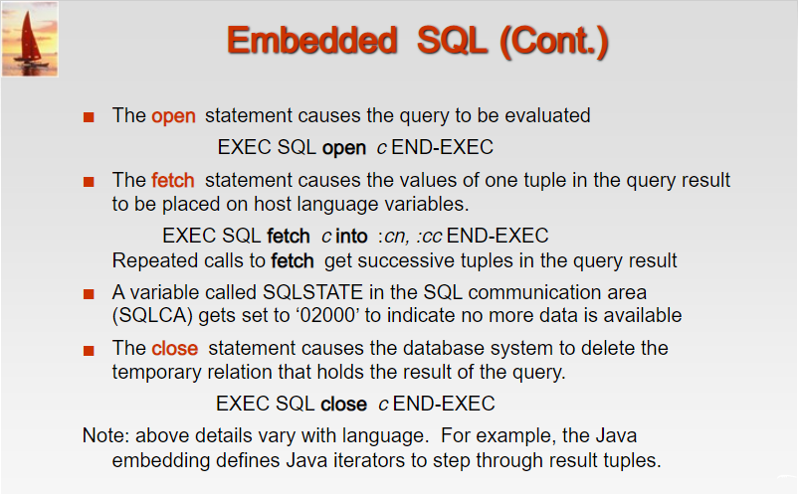

Slide 73
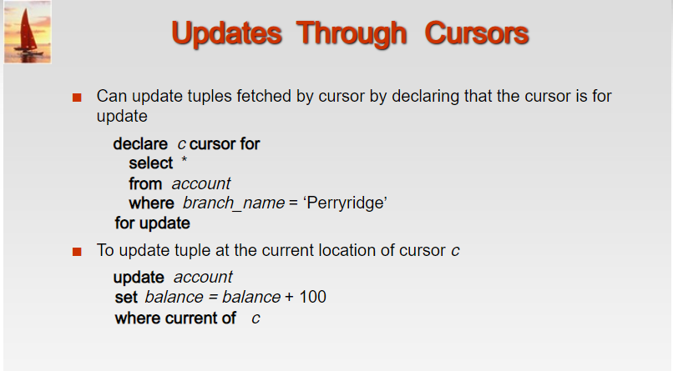

Slide 74
End of Chapter 3

Slide 75
Figure 3.1: Database Schema
branch (branch_name, branch_city, assets)
customer (customer_name, customer_street, customer_city)
loan (loan_number, branch_name, amount)
borrower (customer_name, loan_number)
account (account_number, branch_name, balance)
depositor (customer_name, account_number)

Slide 76
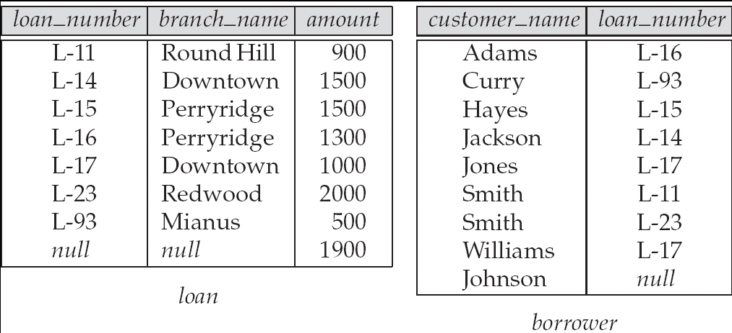
Figure 3.3: Tuples inserted into loan and borrower

Slide 77
Figure 3.4:
The loan and borrower relations

